Slide 1
Exploratory Data Analysis
Best Fracking Hydraulic Group
Sonya Pieklik, Marco Di Leo, Louie Wang, Kelly Chiu, Chris Lawson

Slide 2
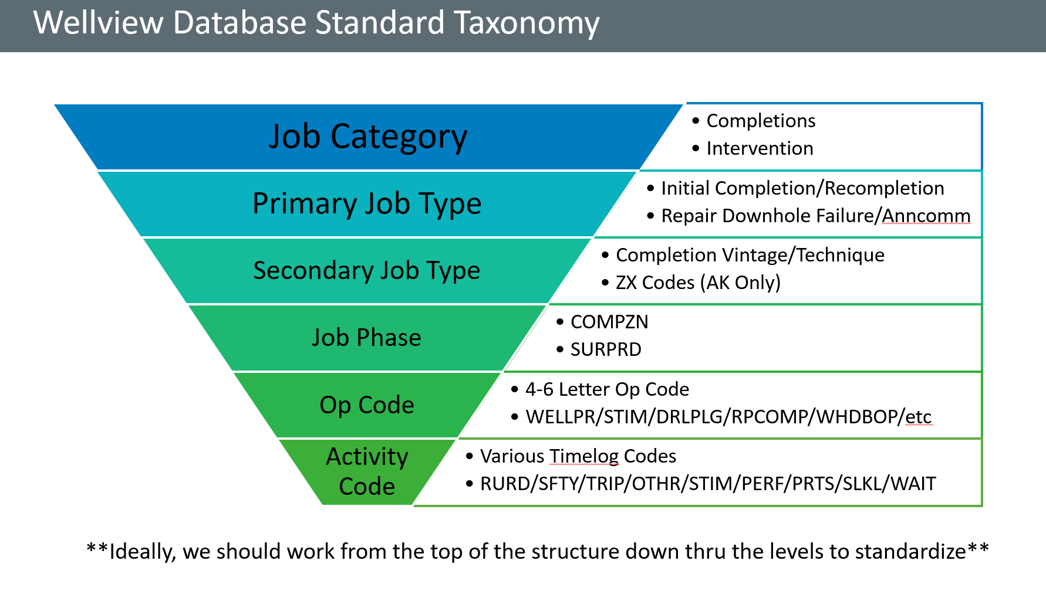
Preview Data
Column names and types of data
Each column represents a feature
49.231% quantitative data
50.769% qualitative data
Features we did not understand
Start date vs. job phase actual start date vs stim int start date
Like kind group (Mechanical Isolation, PP PUC)
We asked our mentor and he showed us the visual on the right and clarified what these features mean

Slide 3
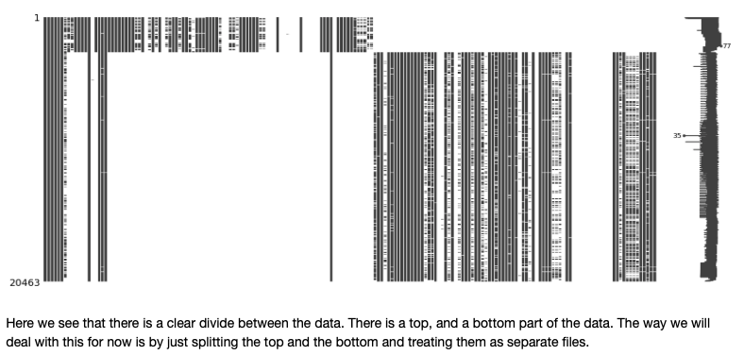
Preview Data Continued
File 1
Initially, we held off on File 1 and focused on the other 3 files because it was missing data (time log), and may have had incorrect merges of datasets
We recently received the new files, but have not had time to properly analyze them

Slide 4
Check shape of data
* currently there are 3 datasets that are we are able to work with.
Recompletions: 99 features (17 of them are completely empty) -- 36 quantitative (non-empty), 1,655 samples
Stimulation stage: 98 features (15 of them are completely empty) -- 38 quantitative (non-empty), 17,721 samples
Monthly production: 8 features -- 4 quantitative, 21,968 samples
*More detailed descriptive statistics for each file are in the next couple of slides
* didn’t have enough time to conduct analysis for added 3 new files
Notes:
Timelog: 21,998 samples
Trouble_time_detail: 152,723 samples
Stim_stage_detail: 182 features, 20,463 samples

Slide 5
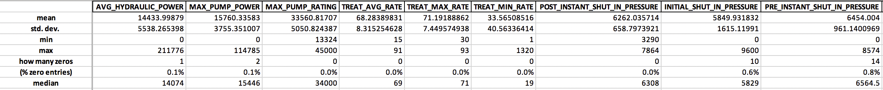
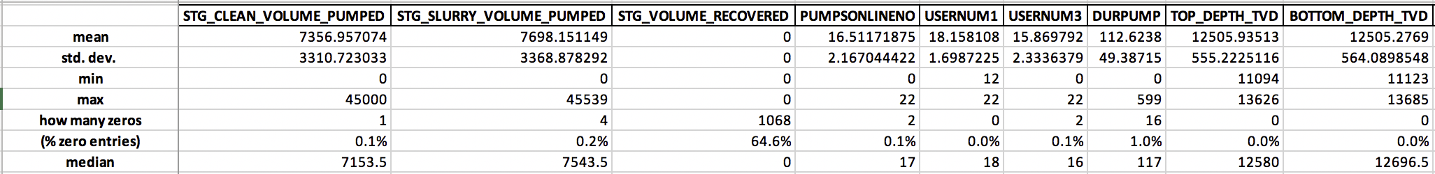
Descriptive Stats of the Data
Recompletions file (statistical descriptions of features that are: non-empty, quantitative) (sample size: 1655)
Feature “STG_VOLUME_RECOVERED” has all zero entries (otherwise it’s empty), so this feature may not be relevant for the learning models.
Most samples have these features filled, except for 3 features below (“PROPPANT_IN_WELLBORE”, “PROPPANT_RETURN_TO_SURFACE”, and “STG_VOLUME_RECOVERED”)
Some features appear to be numeric but may be one hot encoded/categorical features. (eg. USERNUM#)

Slide 6
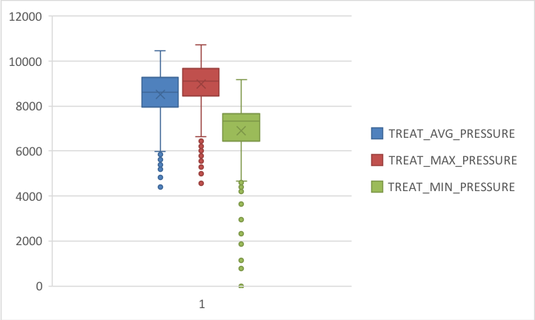
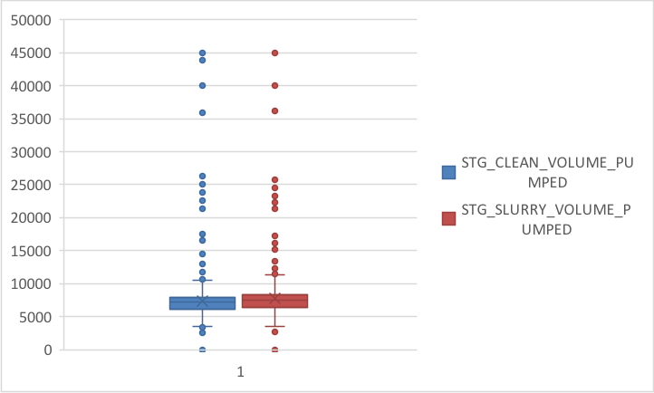
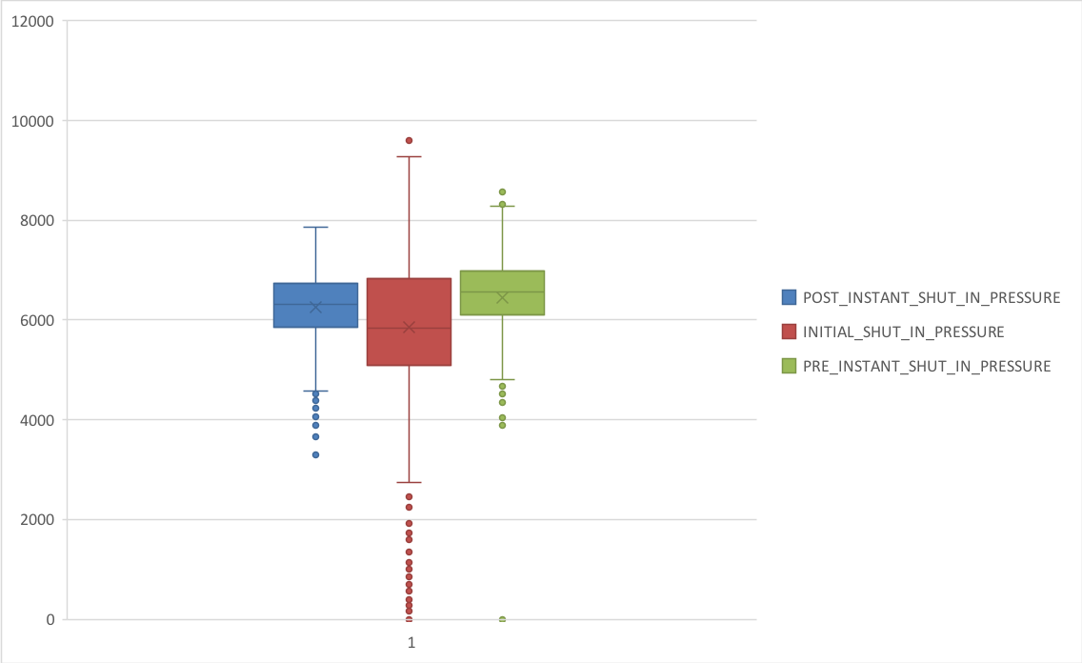
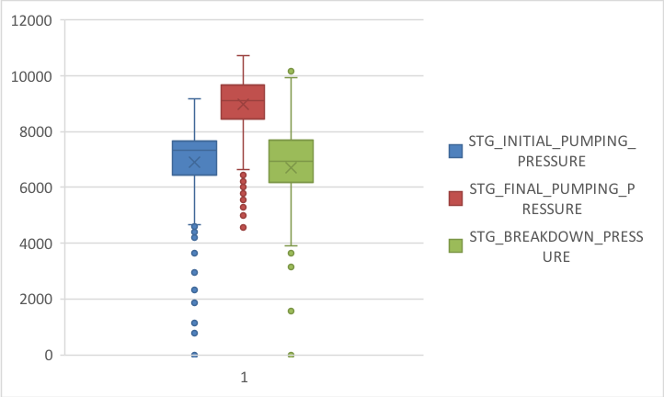
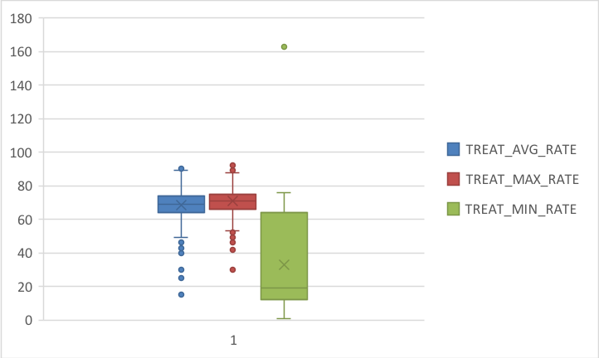
Some boxplots of selected features
(well filled,
relatively low std. dev.,
no extreme outlier )
Notes:
My guess for those really extreme outliers is that there might be a typo for the entry (eg. one extra 0 at the end)

Slide 7
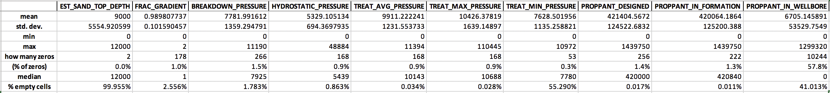
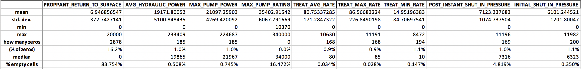
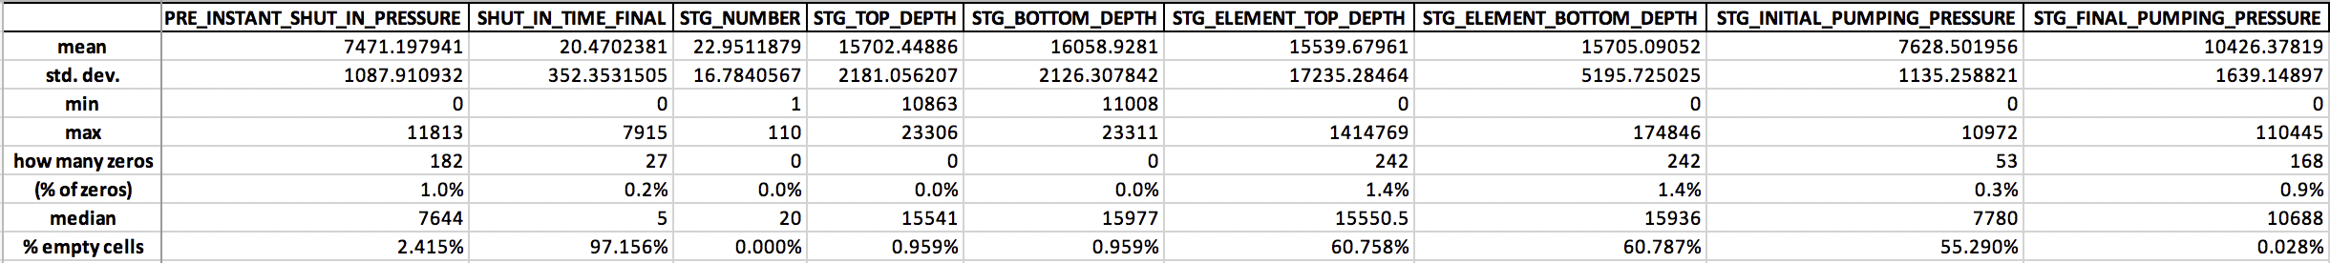
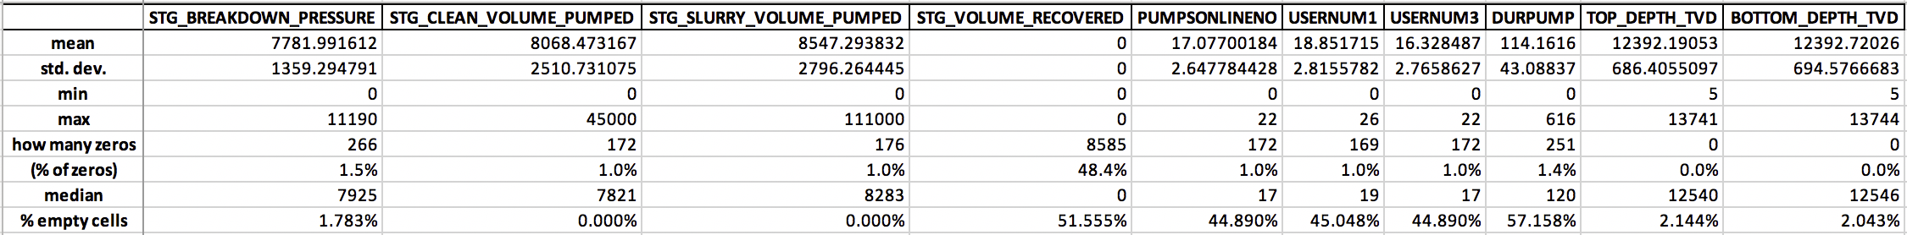
Descriptive Stats of the Data
Stimulation stage file (statistical descriptions of features that are: non-empty, quantitative)(sample size: 17721)
For some features, they are either containing lots of 0’s or almost being empty. We may decide to ignore those features in our learning models if we’ve found enough evidence saying that the existing sample entries are not significant. (“EST_SAND_TOP_DEPTH”, “PROPPANT_RETURN_TO_SURFACE”, “SHUT_IN_TIME_FINAL”)
Similar to the recompletions file, some features appear as numeric but are one hot encoded (eg. USERNUM#).

Slide 8
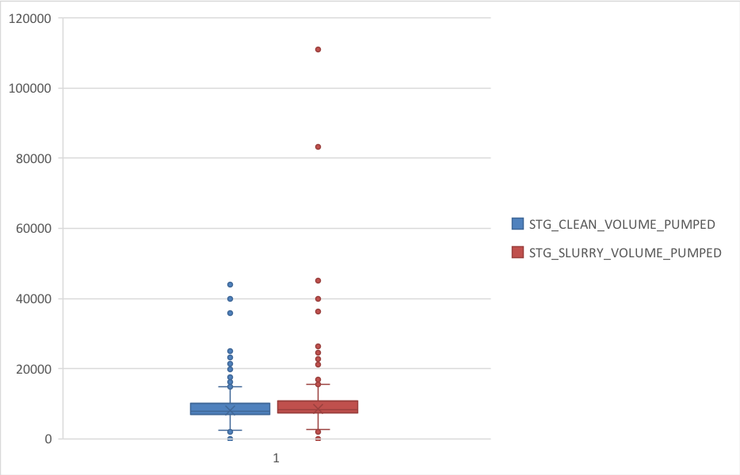
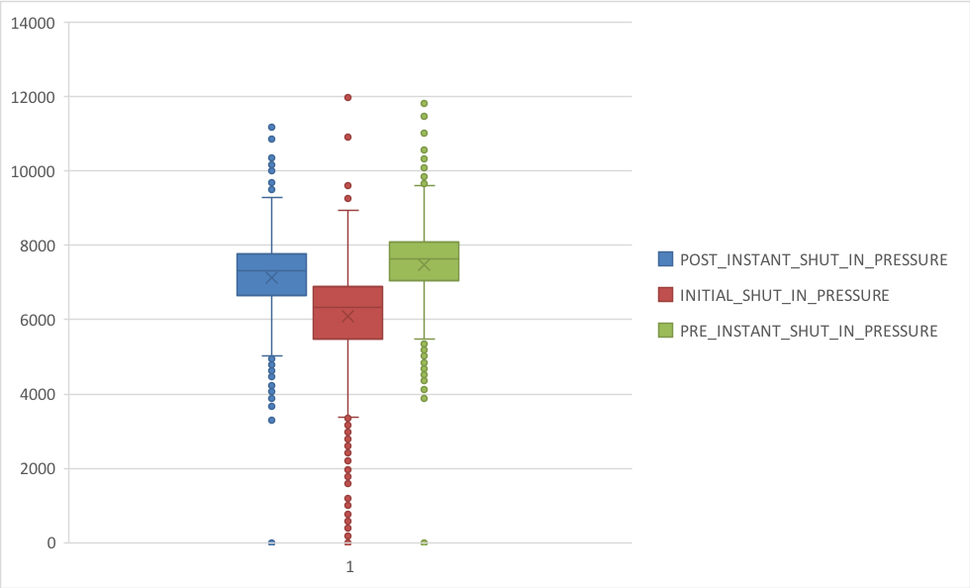
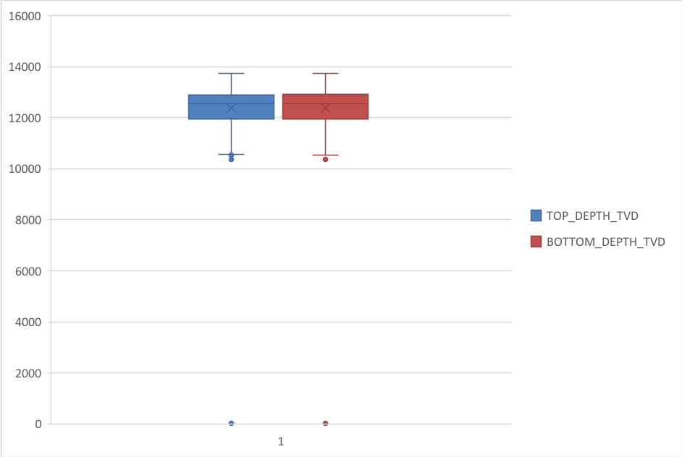
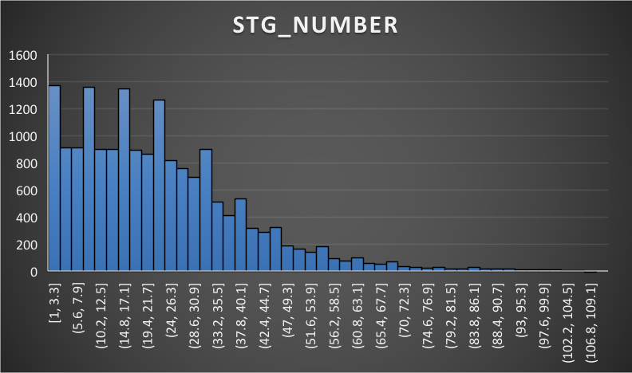
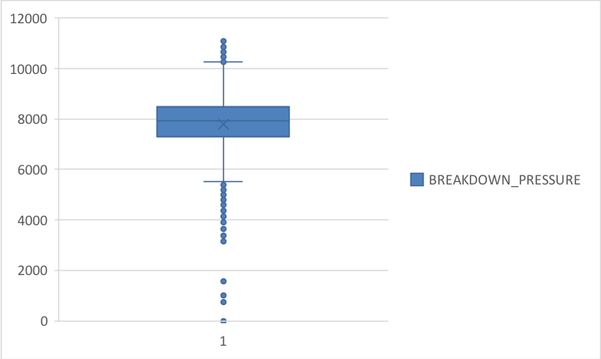
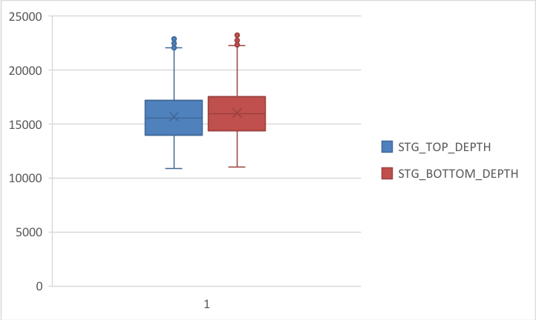
Some boxplots、histograms of selected features
(well filled,
relatively low std. dev.,
no extreme outlier )

Slide 9
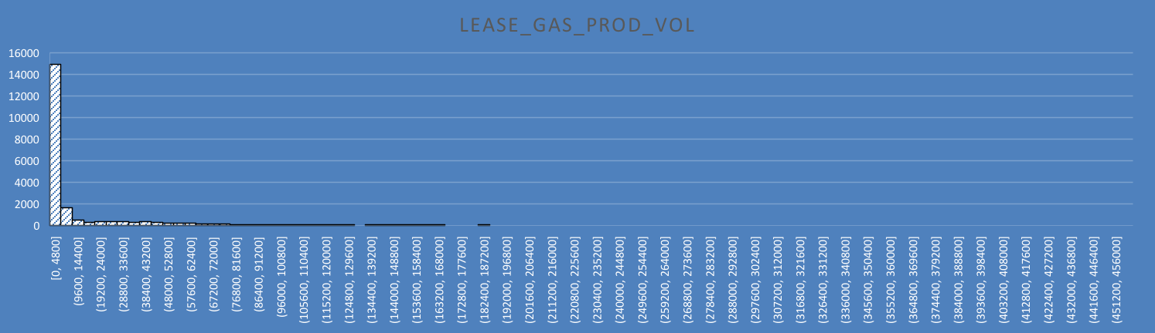
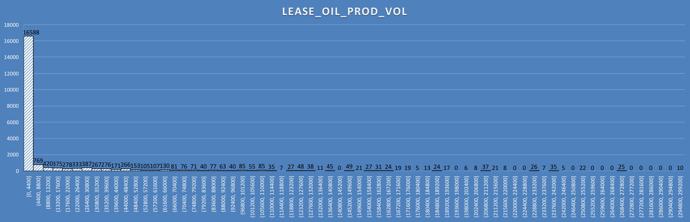
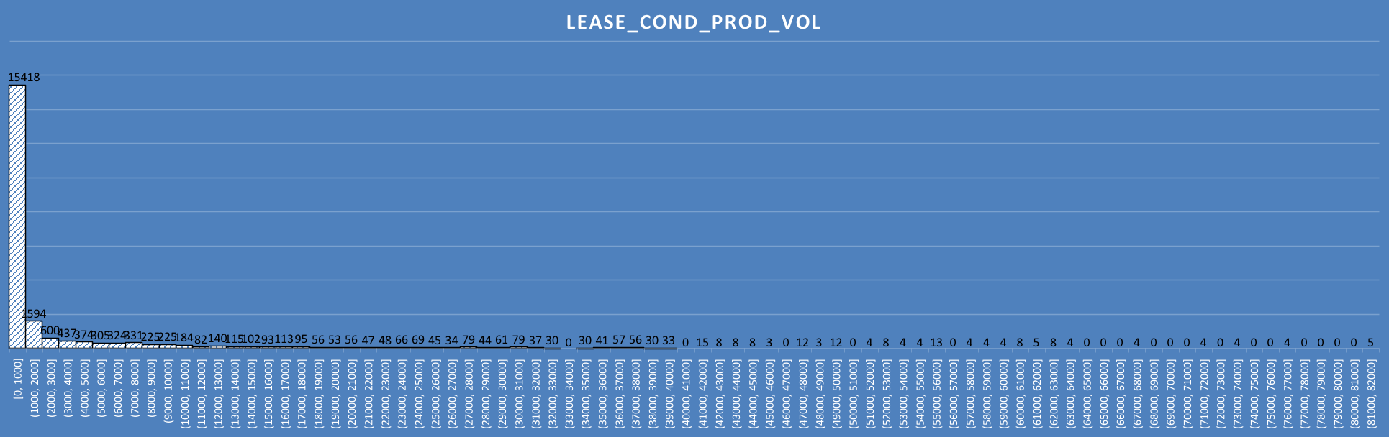
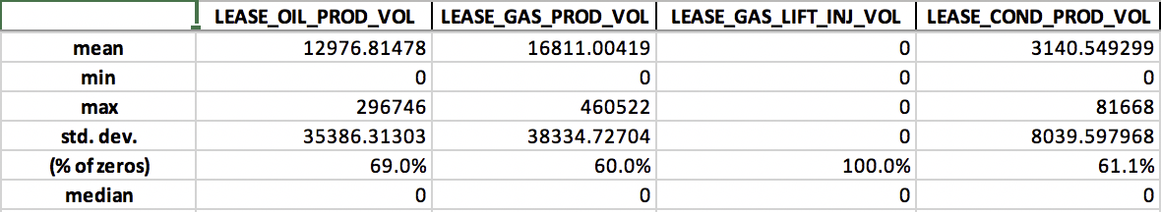
Descriptive Stats of the Data
Monthly production file (sample size: 21968)
The feature “LEASE_GAS_LIFT_INJ_VOL” has 0’s for all samples (maybe this feature is then irrelevant to our learning models)
High variances;
More than half of their entries are 0’s (explains why the medians are all 0’s)
Histograms of features that contain non-zero entries:
extreme right skew,
dominating mode,
wide range of outliers.

Slide 10
How many Null values
How many values are missing?
Recompletion Stages File
Total Features: 99
Stimulation Stages File
Total Features: 98
Monthly Production File
Total Features: 8
% Missing | # Features
[0%, 25%) | 59
[25%, 50%) | 7
[50%, 75%) | 10
[75%, 100%] | 23
% Missing | # Features
[0%, 25%) | 61
[25%, 50%) | 4
[50%, 75%) | 10
[75%, 100%] | 23
% Missing | # Features
[0%, 25%) | 8
[25%, 50%) | 0
[50%, 75%) | 0
[75%, 100%] | 0
Notes:
Ensemble method or simple models to run

Slide 11
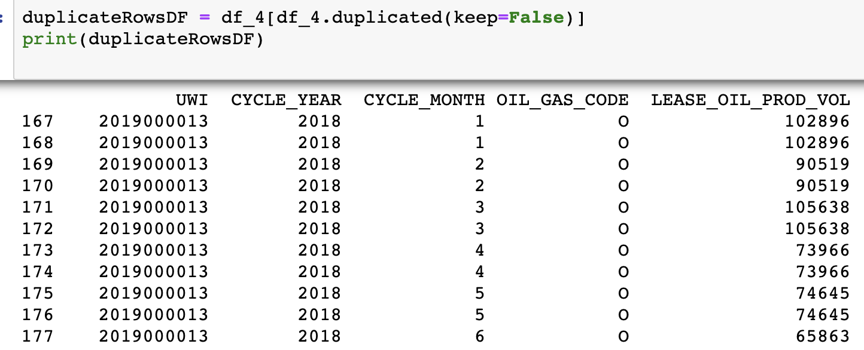
Duplicate Samples
Only the Monthly Production file had duplicate samples.
5699 sample duplicates out of 21968 samples
Notes:
Are there duplicate samples or features?
What about derivative features (normalized features)?

Slide 12
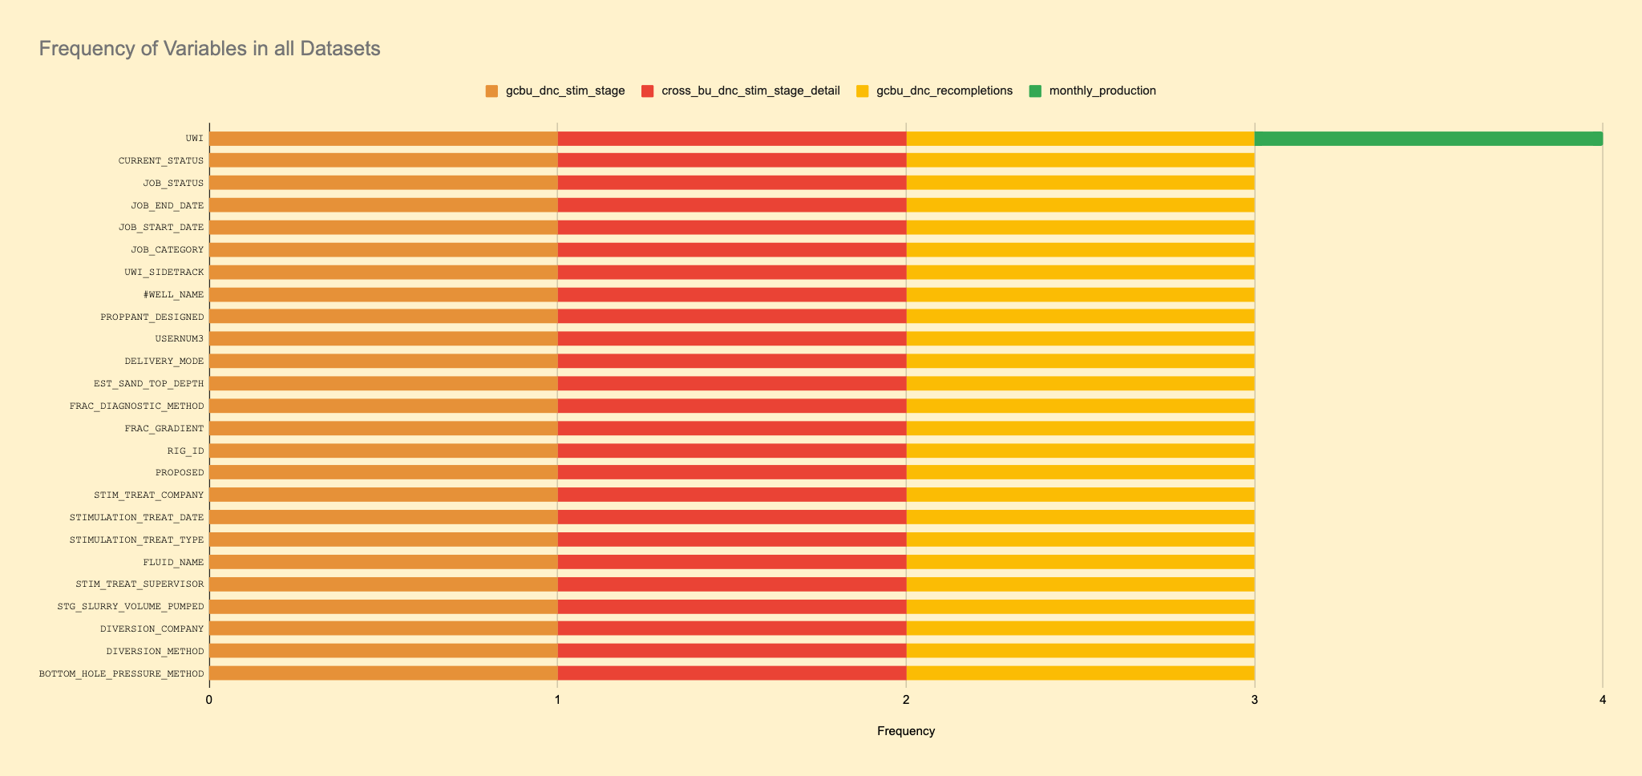
Duplicate Features
On average, a feature will appear 2.365482234 times in all of the datasets.
UWI feature appears on all four datasets
STG (stage) type features have a higher frequency
Monthly production features only appear in file (besides UWI)
How to read frequency charts:
File origin
Feature Names
Count/Frequency

Slide 14
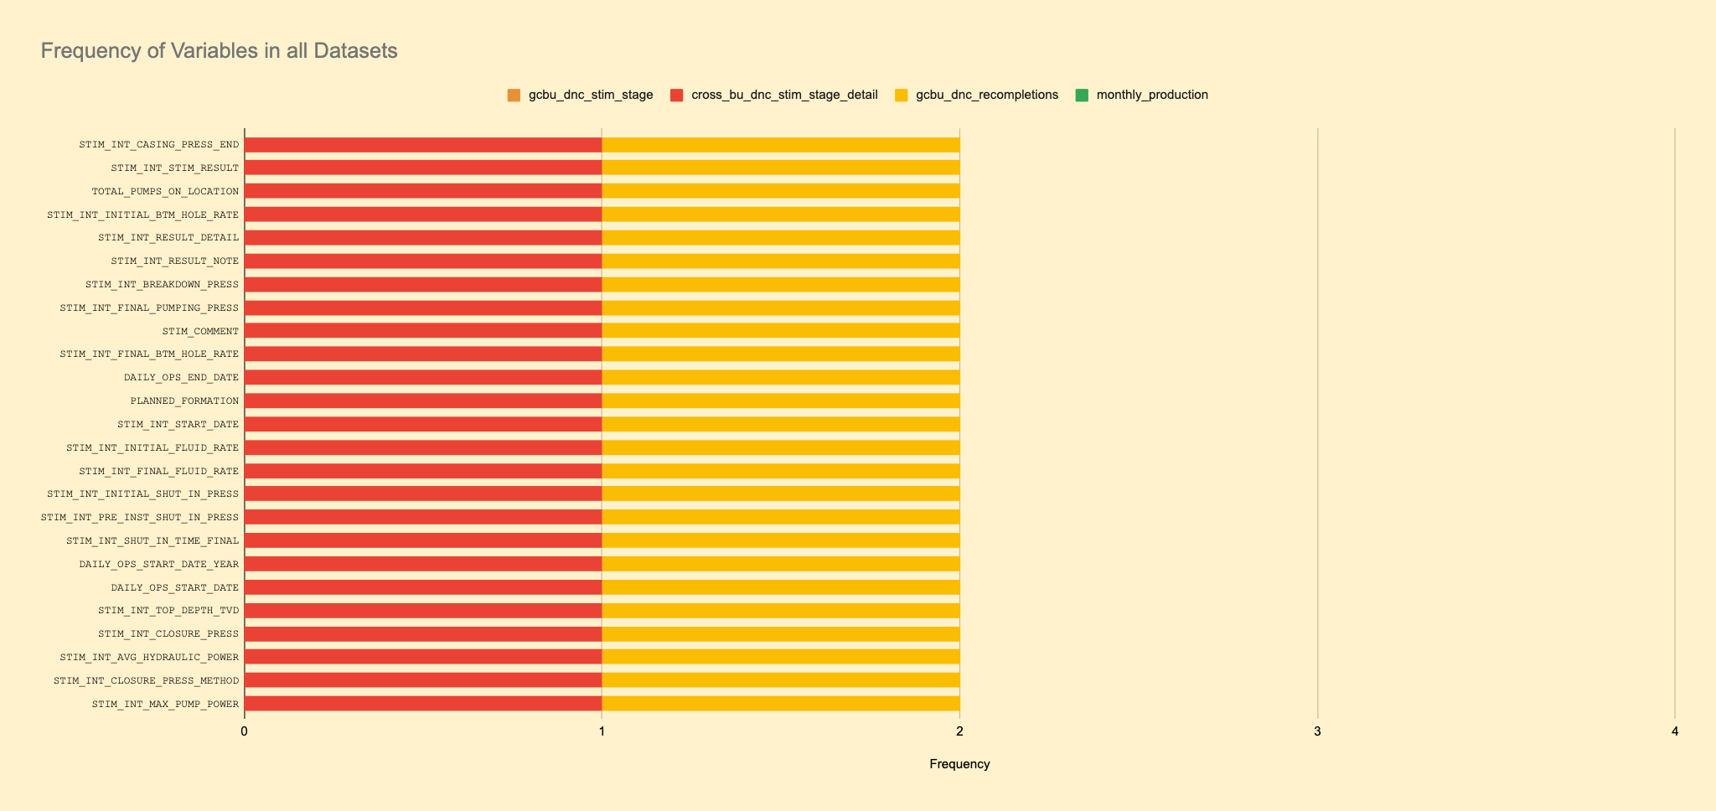

Slide 15
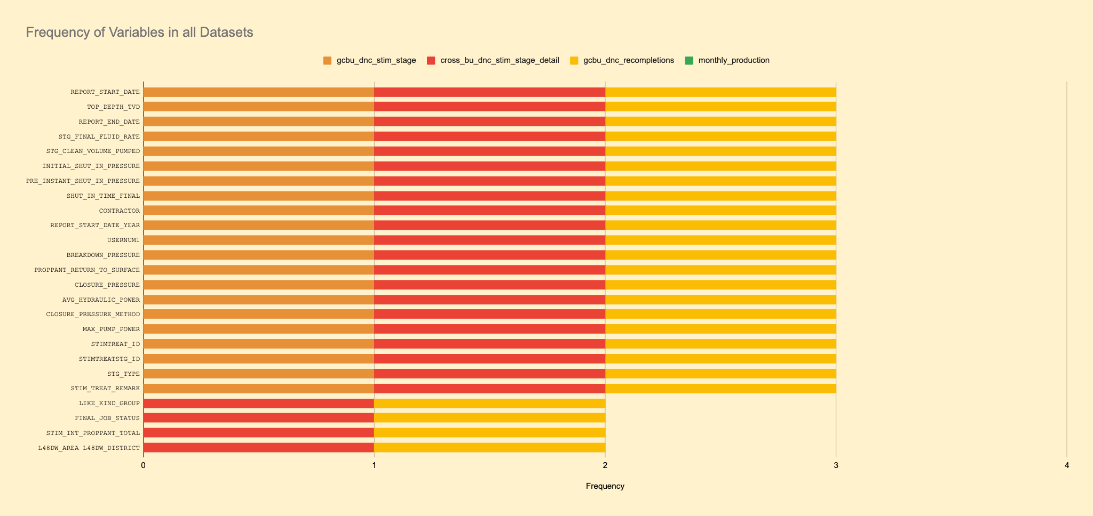

Slide 16
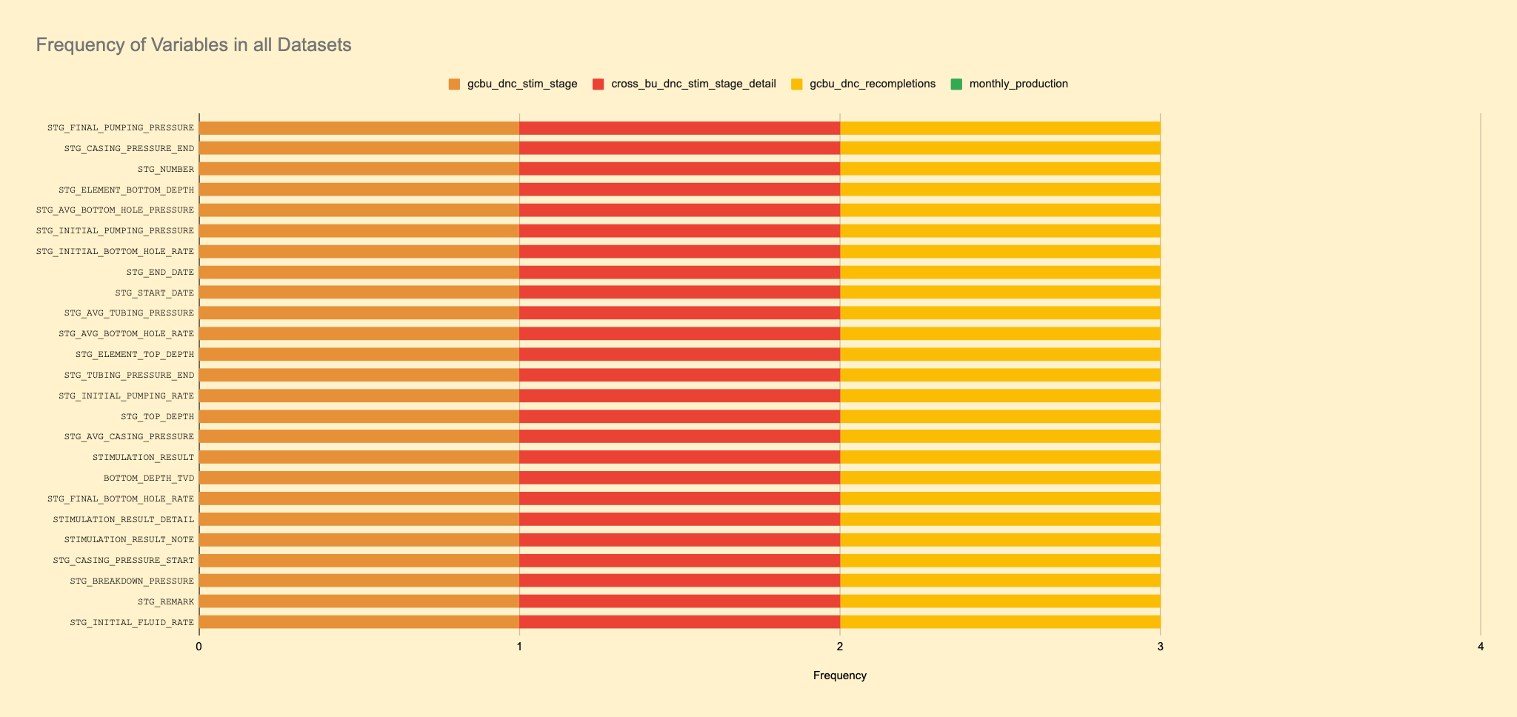

Slide 17


Slide 18


Slide 19
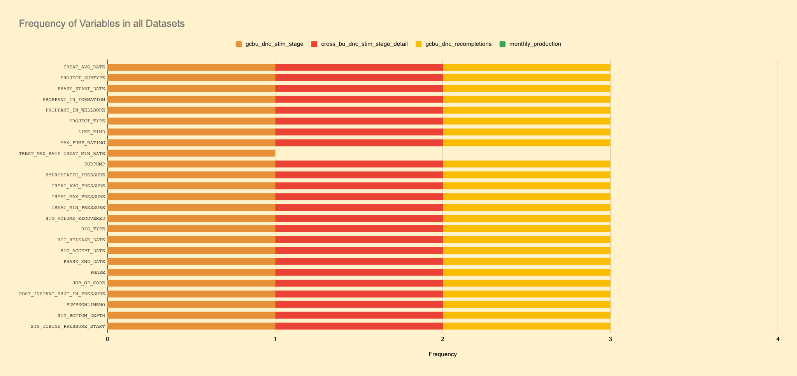

Slide 20
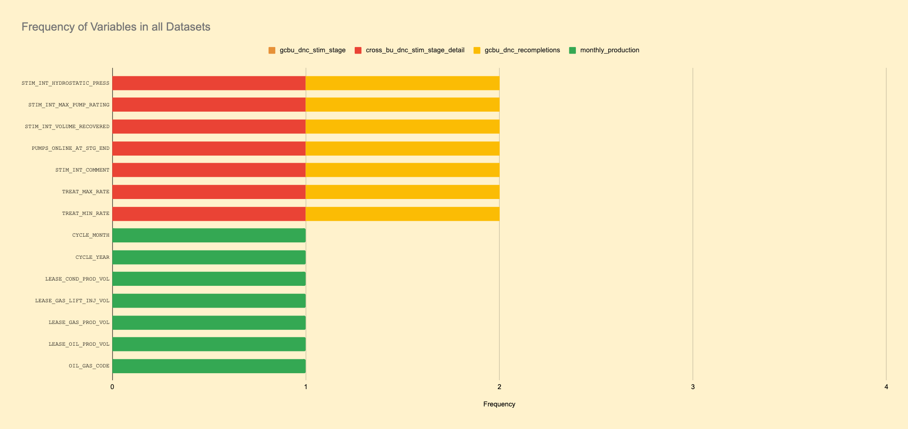

Slide 21
Understanding Quantitative Data
Process
For each of the different files, we separated the features based on important features. This is because some of the quantitative variables were not important. (i.e. Unique Well Id’s and Stage Numbers)
Recompletion data and Stimulation Data was split into features related to pressure and all other engineering variables
Production data was not split as all features were important

Slide 22
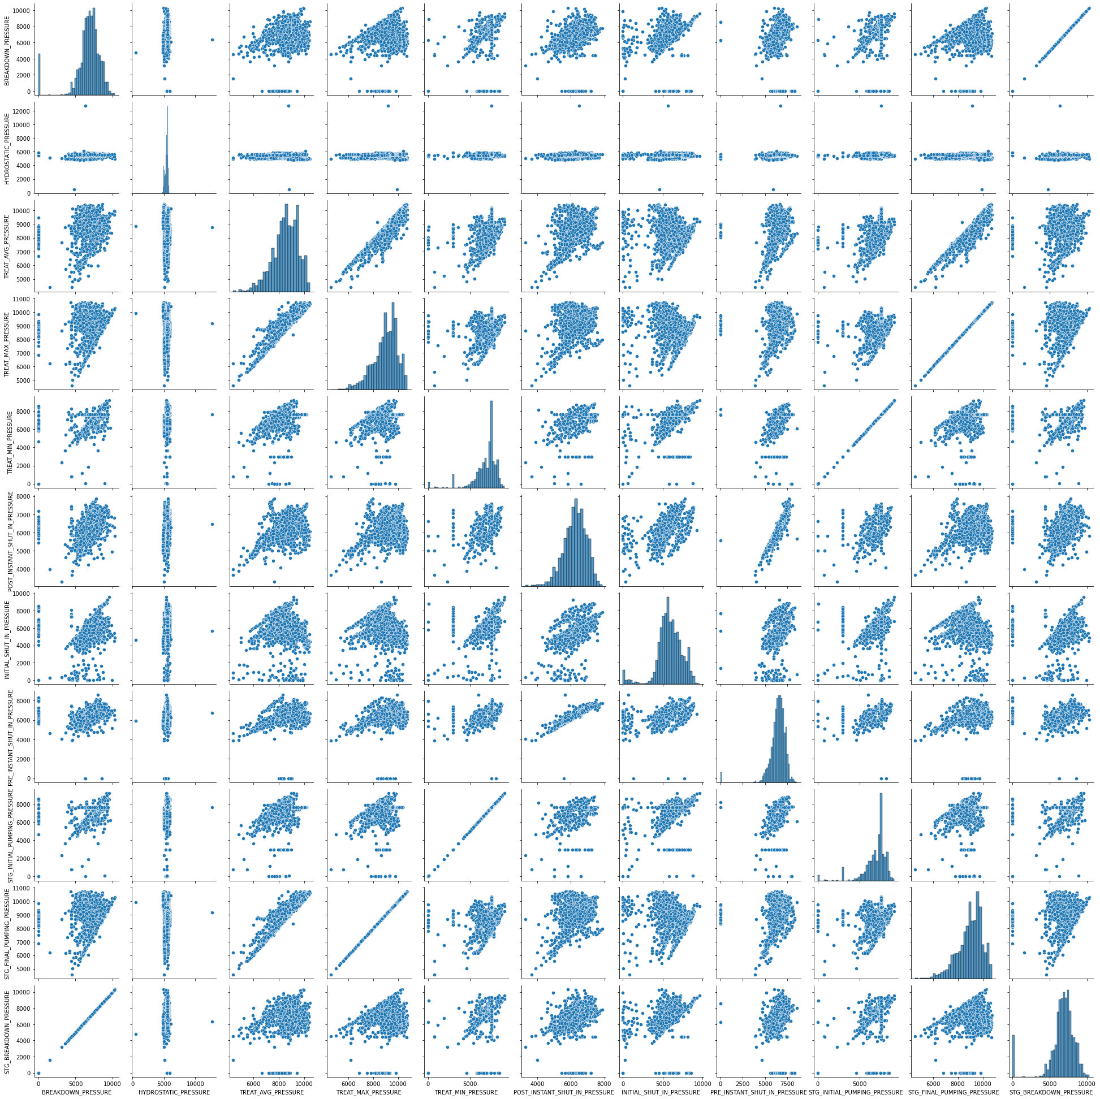
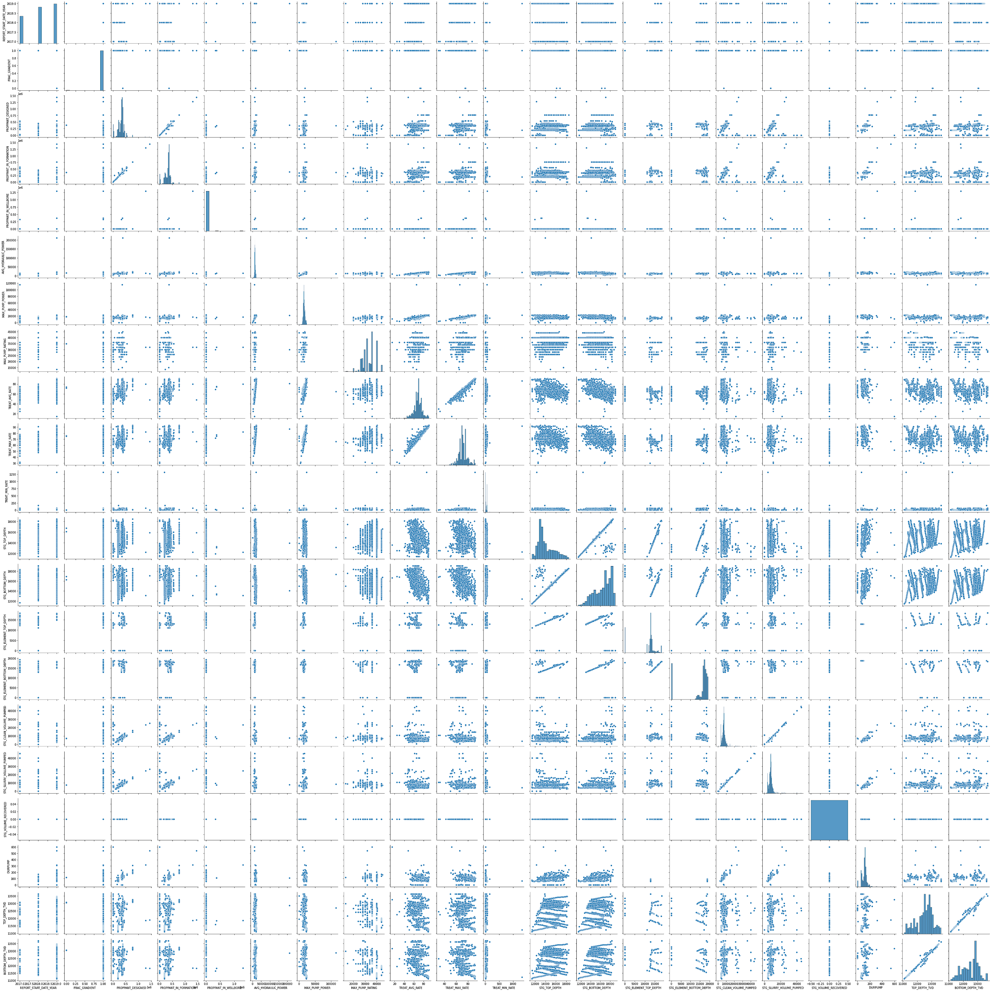
Understanding Quantitative Data
Recompletion
Pressure features
Remaining Engineering features
Initial Reactions
There are some interesting relationships to pursue in the pressure features (in the bottom right corner) that we are considering pursuing further.

Slide 23
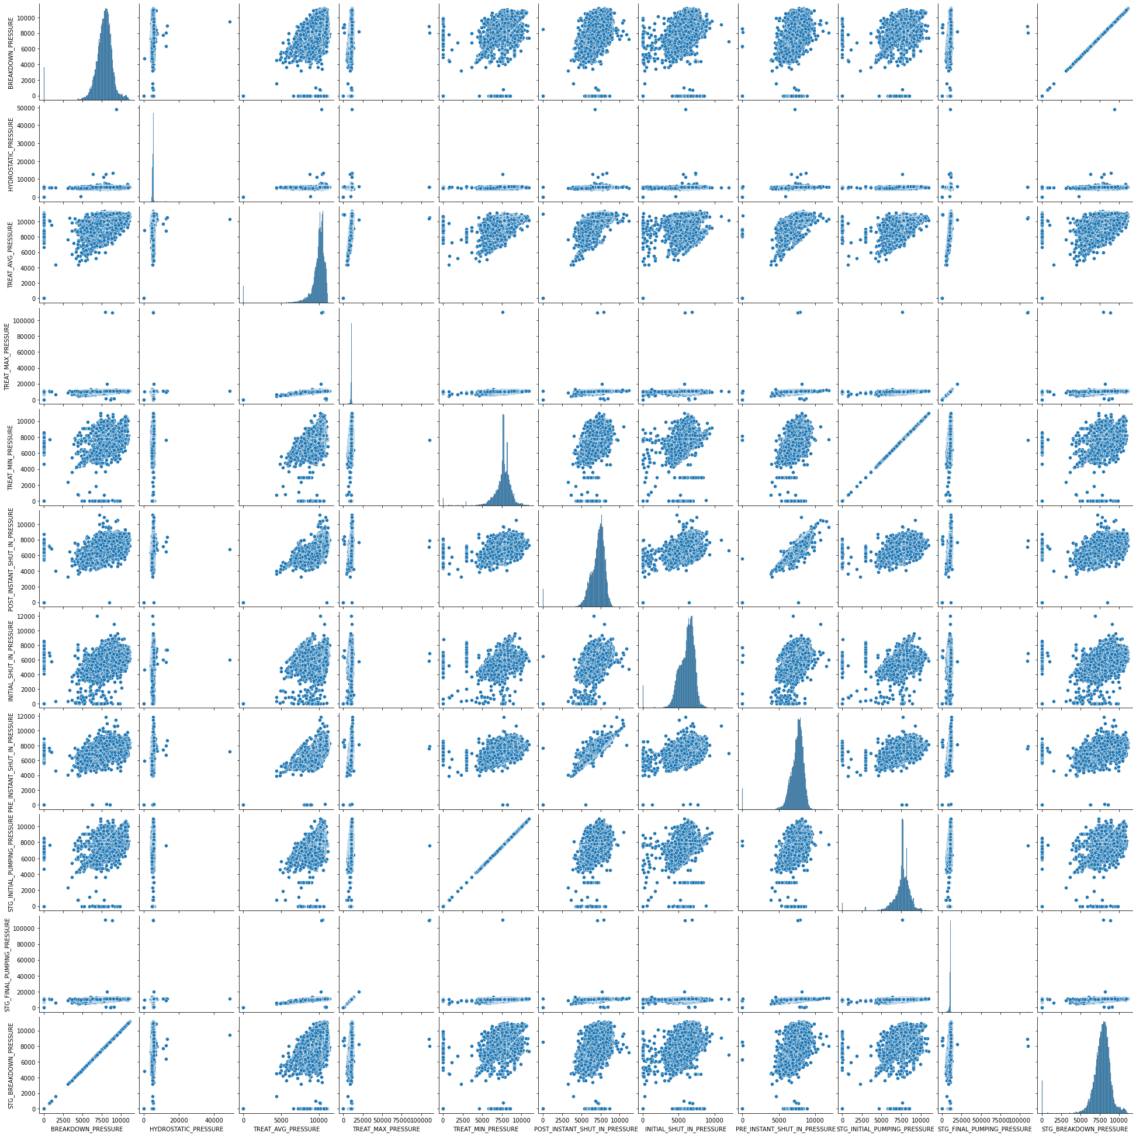
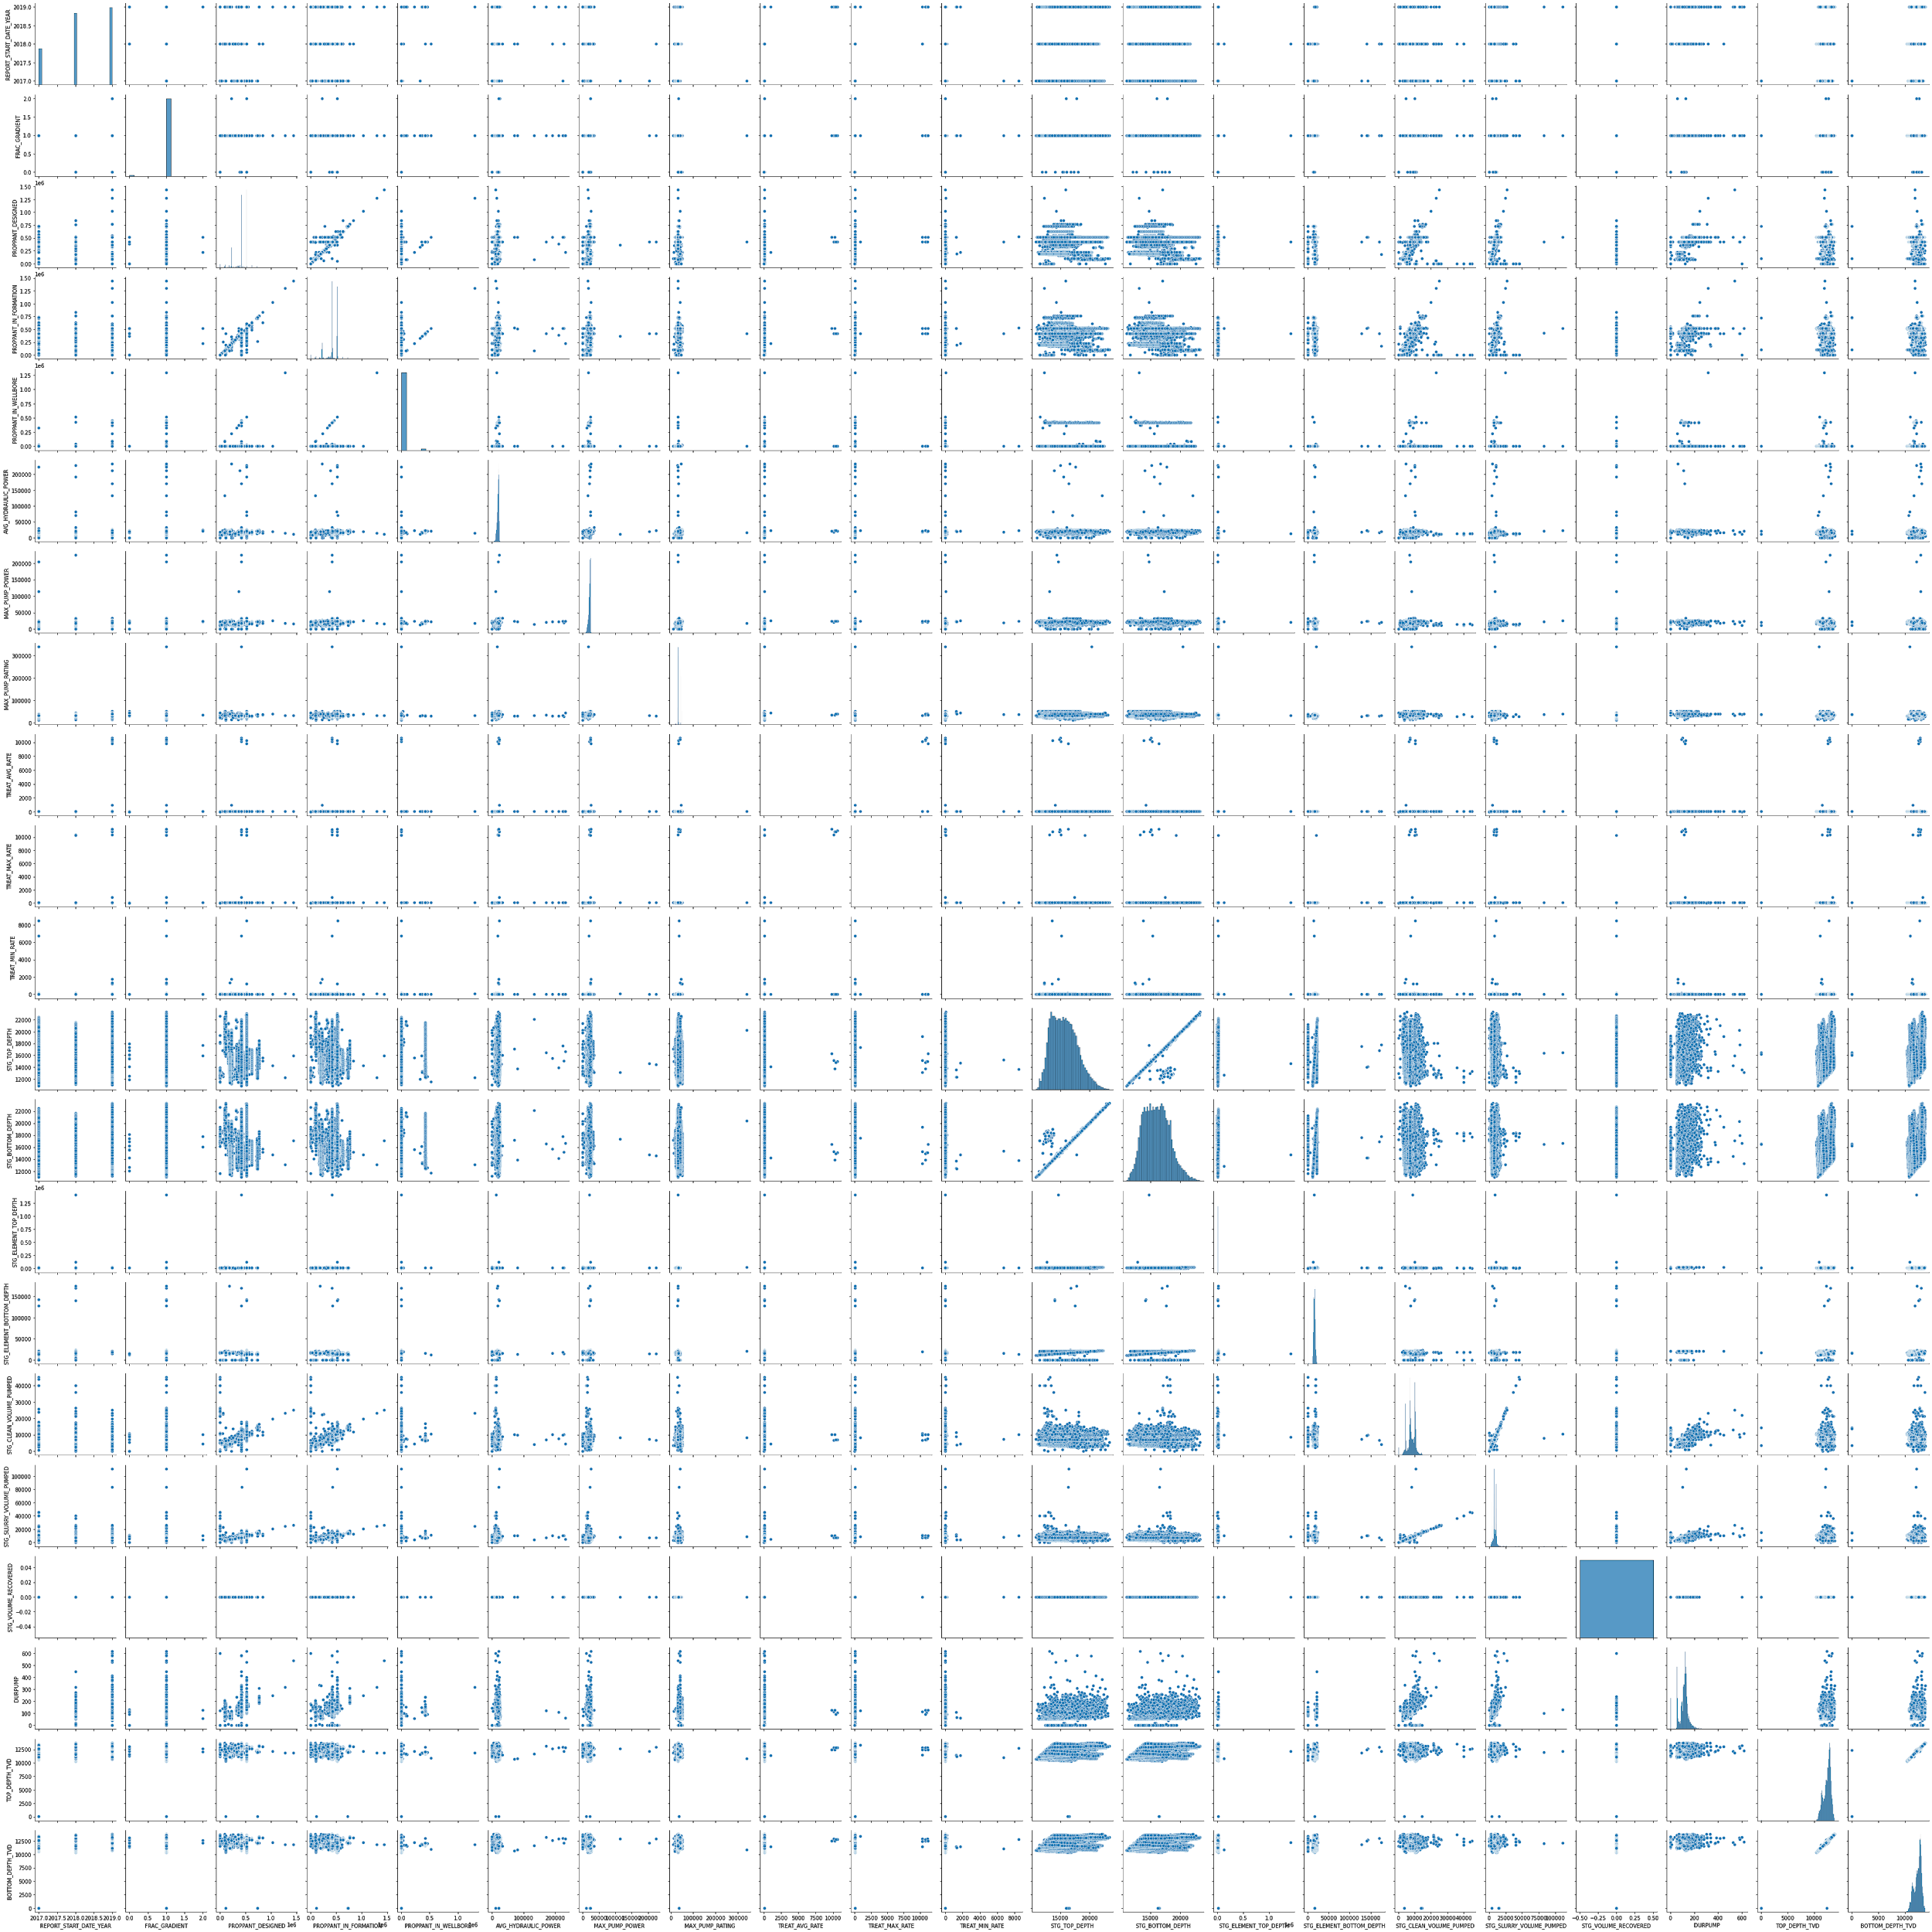
Understanding Quantitative Data
Stimulation Stages
Pressure features
Remaining Engineering features
Initial Reactions
Similar to with the Recompletion data, the more interesting relationships are with the pressure features. So going forward, we’ll be looking at those pressure features closely

Slide 24
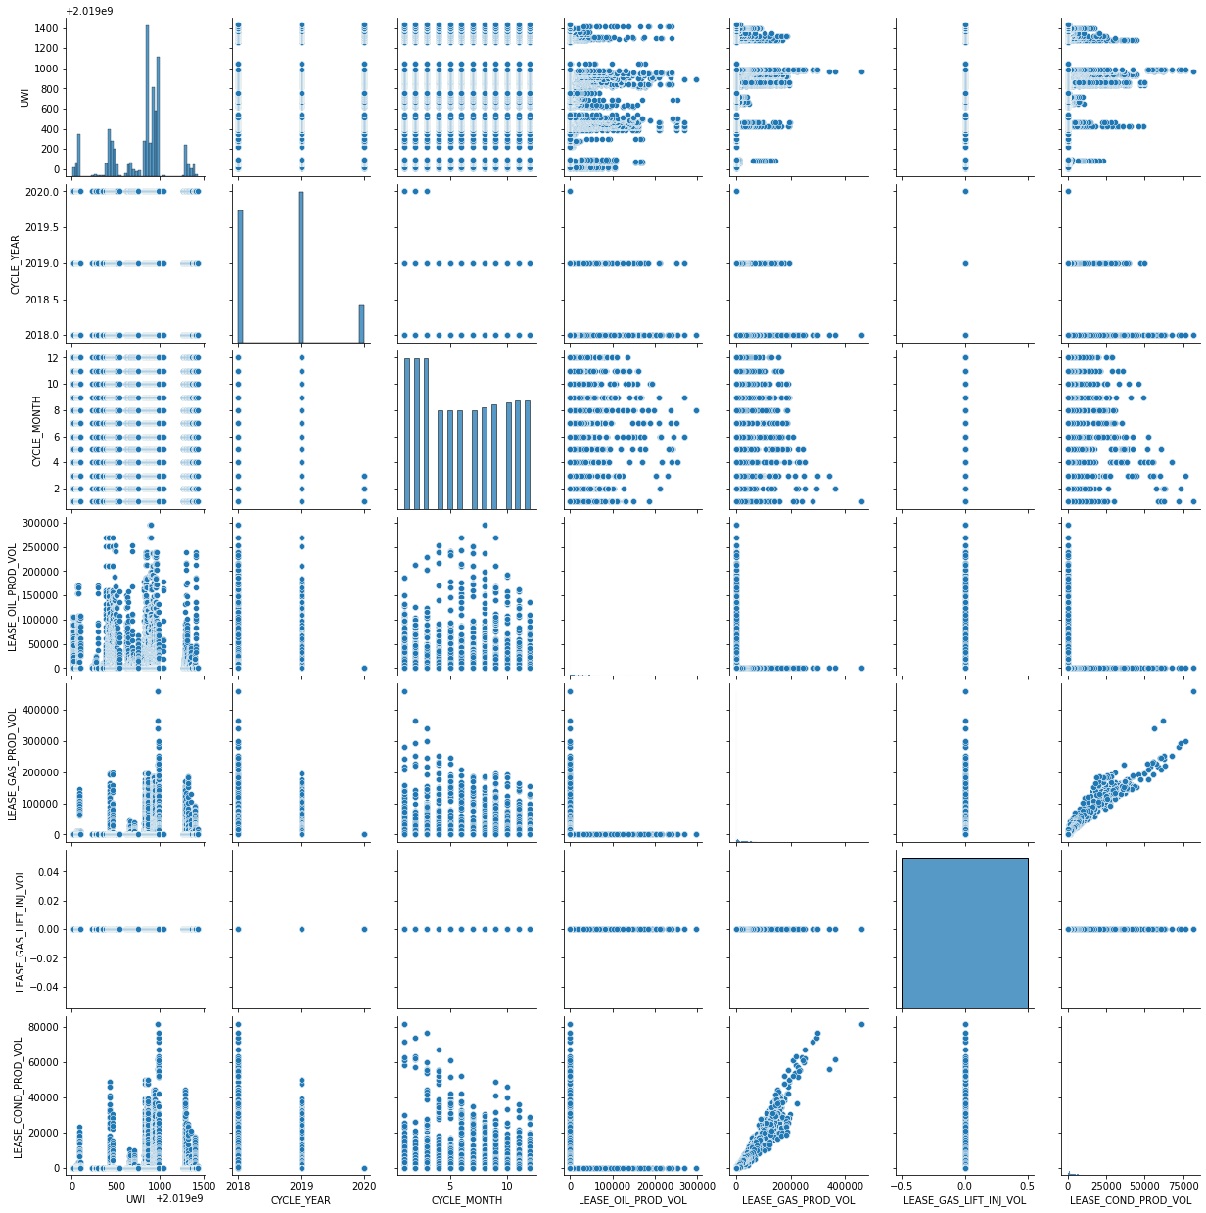
Understanding quantitative data
Production
Initial Reactions
There doesn’t seem like there is any kind of relationship between any of the production features.
However this does not mean it will be important as all the files have been analyzed against features within their own files. We still have yet to see how features mix and match across different files. As this should show more valuable information.

Slide 25
Understanding Quantitative Data
Conclusions
The pairplots for recompletion and stimulation stages are nearly identical
For both of these plots, the more interesting relationships came out of the pressure variables than the other engineering variables
This means that we will be looking closely at those variables moving forward
Nothing interesting in the production pairplot
Points to consider going forward
Here the files were plotted up against themselves, there could be features that relate to each other that are in separate files
We need to consider merging all of our data to try to get a better understanding of the basic relationships in the data

Slide 26
Understanding qualitative data
Process
First remove qualitative features that are unstructured.
Can include comments made by the frac crew that is operating
Get rid of dates (will be used for creating new interpolated features such as duration)
Use label encoding to view percentage make up of different labels and pairplots to view the results
Nothing done with production as all features are quantitative

Slide 27
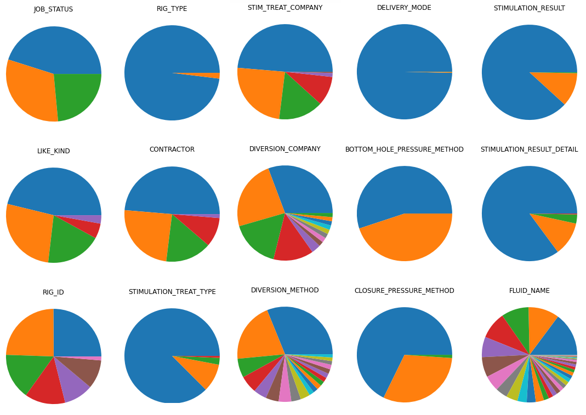
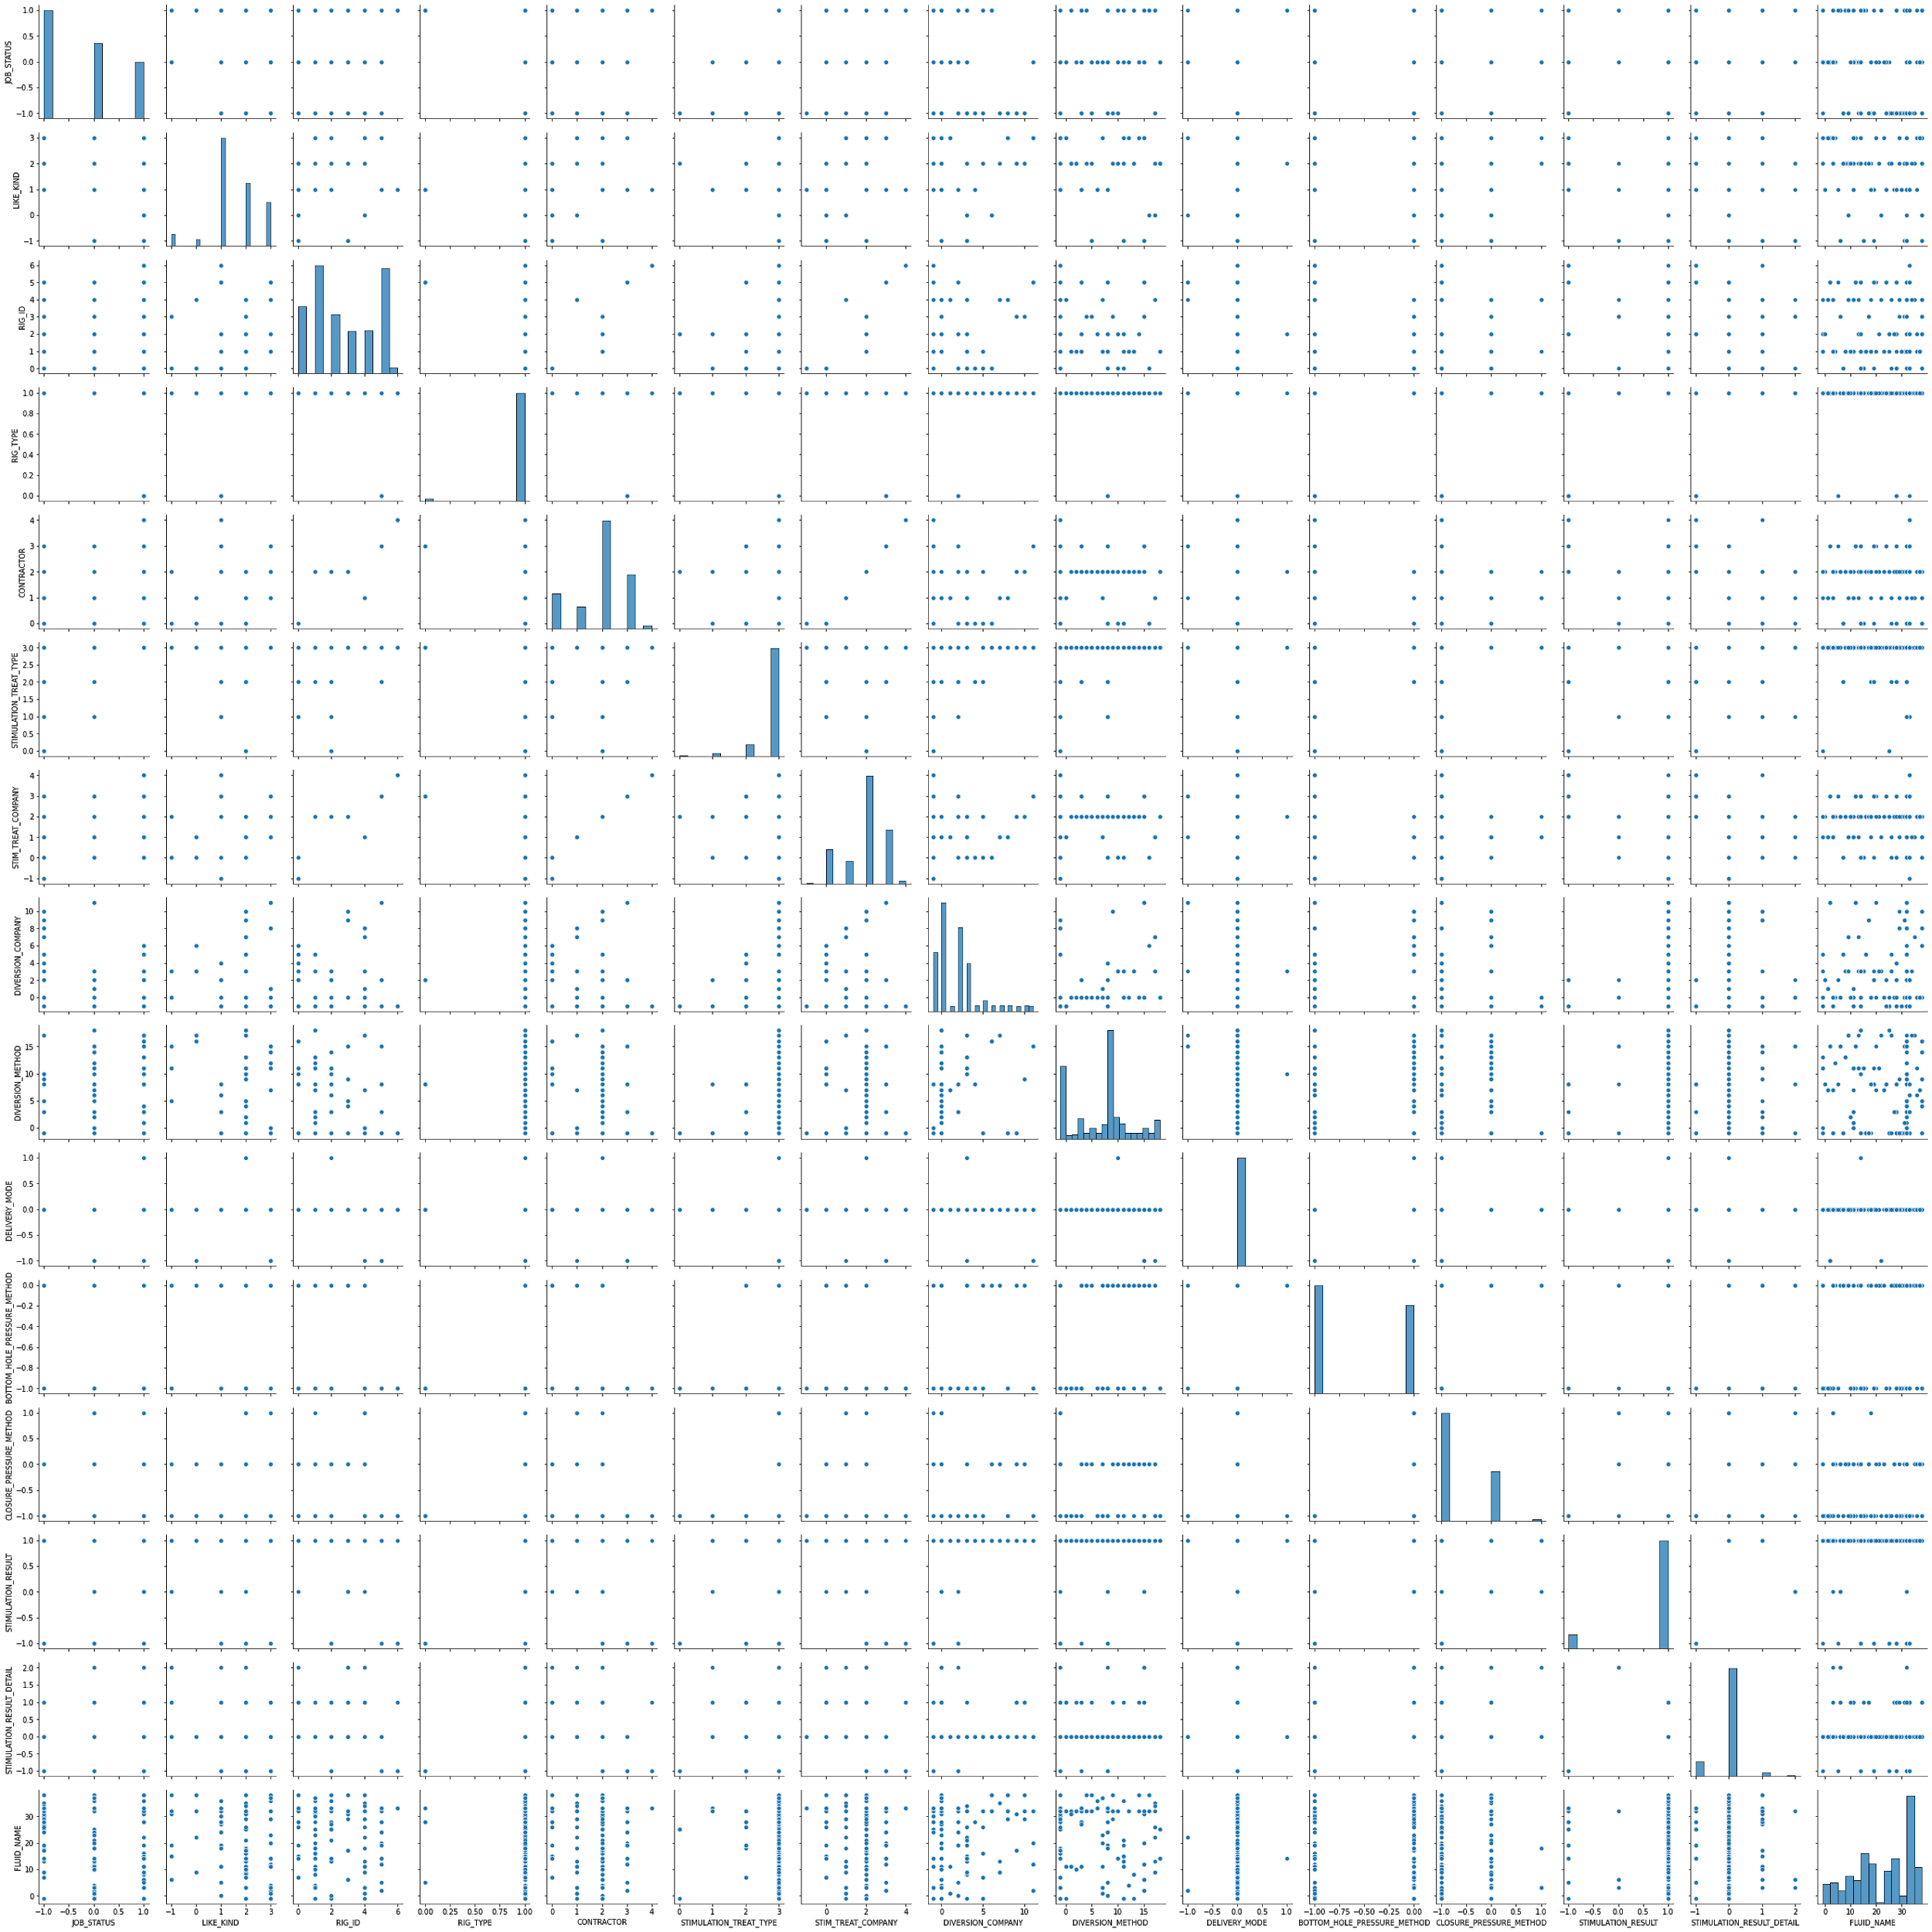
Understanding qualitative data - Recompletion
Percentage makeup of different labels
Pairplot against other labels

Slide 28
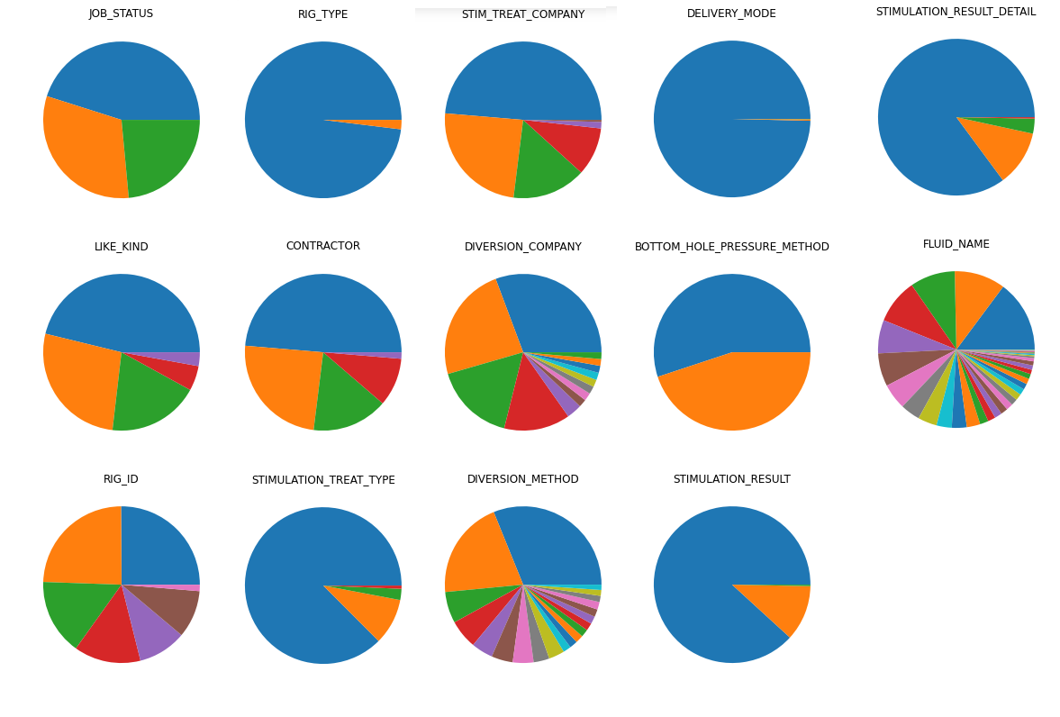
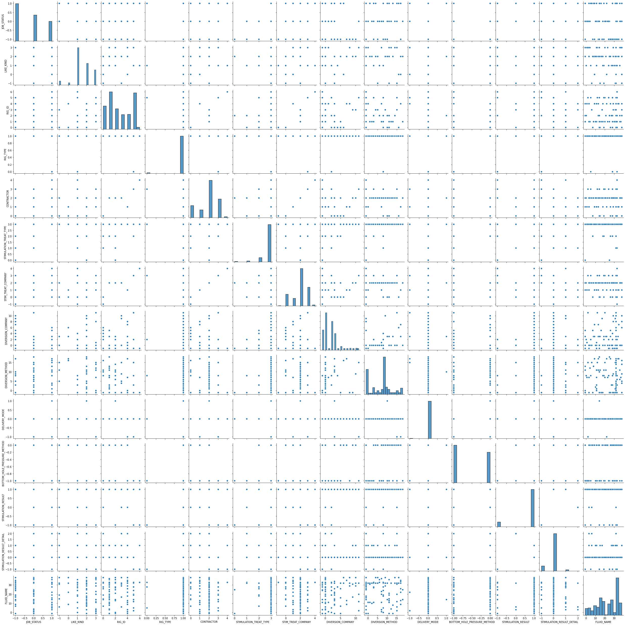
Understanding qualitative data - Stimulation Stages
Percentage makeup of different labels
Pairplot against other labels

Slide 29
Understanding qualitative data
Conclusions
The label distributions between the Recompletion data and Stimulation data were very similar.
Pairplots of this data did not look very interesting
Points to consider moving forward
With numerical labels, we should consider merging this new information with our quantitative data to see if anything arises between the different groups of labels.

Slide 30
Investigating Important Values
What values should we focus on next?
With such a variety of data to sample and train our models to, we have a lot of options as to what variables we value
Based off of our meetings with our mentor we have concentrated on a few interesting ones
Important Values:
Proppant Volume, Stages, Stage Length, Stage depth
STG_ NUMBER | STG_TOP_ DEPTH | STG_BOTTOM_ DEPTH | STG_SLURRY_VOLUME_ PUMPED | PROPPANT_ DESIGNED | Rig Time (days) | Stage Time | Stage Time (hrs) | Stage Length | Average Stage Depth
58 | 10863 | 11008 | 7926 | 420000 | 20 | 0.0736 | 1.7666 | 145 | 10935.5

